Slide 1
Capstone Project
Zomato Restaurant Clustering and Sentiment Analysis
Team Members
LAKSHMI KEERTHANA

Slide 2
Points to Discuss
Problem Statement
Data Summary
Data Cleaning
Exploratory Data Analysis
Data Preprocessing
Model Training
Sentiment Analysis
Conclusion
Challenges

Slide 3
Problem Statement
Zomato is one of the successful on-demand food delivery platforms that helps users discover food places and get it delivered at their doorstep. We can also get accurate information about restaurants as it provides menus, reviews, and ratings.In this project we utilize data analytics techniques to gain a deeper understanding of the restaurants and customer feedback on Zomato.
The data contains the information about the restaurant's name, location, cuisines, average cost for two, ratings, and user reviews. I did the task of data cleaning and preprocessing. Handling missing values and transforming the data into a form that can be used for analysis and visualization.
Implemented clustering on the restaurant data using K means Clustering and Agglomerative Clustering. The objective of this clustering is about grouping the similar restaurants together. The features that were used to cluster the data includes, restaurants, cuisines, Average cost of each restaurant and the rating.
To get the optimum number of clusters, elbow method and silhouette scores were used. Later conducted sentiment analysis on the customers reviews to understand the sentiment towards the restaurants.

Slide 4
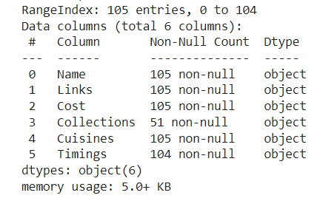
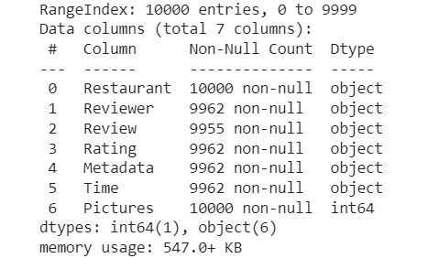
DATA SUMMARY
Restaurant Dataset
Review Dataset

Slide 5
DATA CLEANING
Restaurant DataSet
There are 105 total observation with 6 different features.
Feature like collection and timing has null values.
There is no duplicate values i.e., 105 unique data.
Feature cost represent amount but has object data type because these values are separated by comma ','.
Timing represent operational hour but as it is represented in the form of text has object data type.
Review DataSet
There are total 10000 observation and 7 features.
Except picture and restaurant feature all others have null values.
Rating represent ordinal data, has object data type should be integer.
Timing represent the time when review was posted but show object data time, it should be converted into date time.
The final shape of the dataset after cleaning the records (1373771,27)

Slide 6
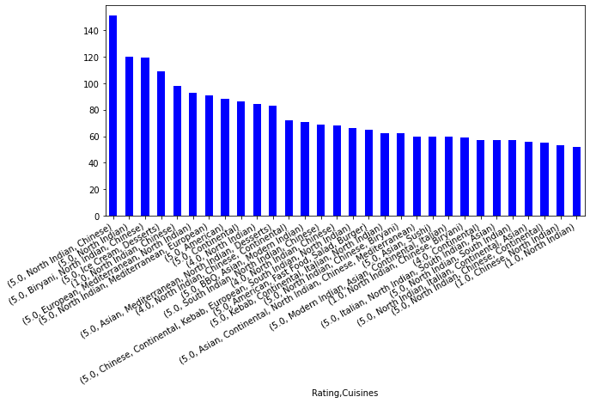
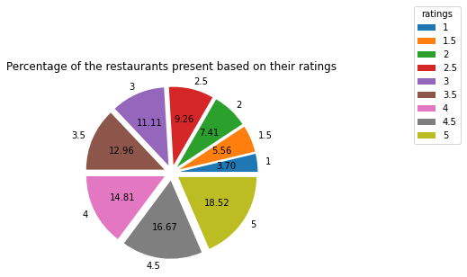
EXPLORATORY DATA ANALYSIS
Percentage of restaurants present based on their ratings
Cuisines:

Slide 7
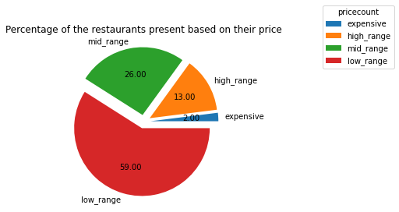
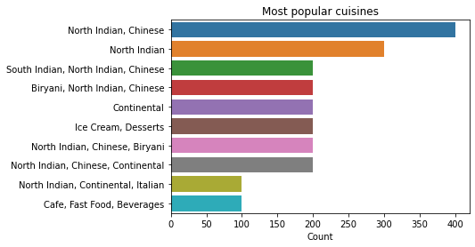
Most Popular Cuisines:
Percentage of restaurants present based on price:

Slide 8
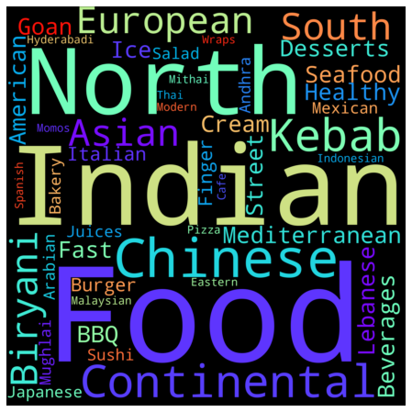
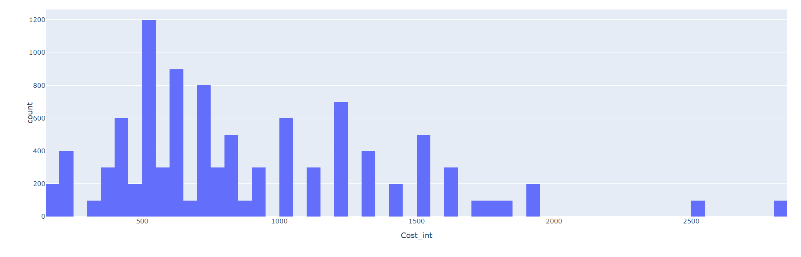
Cost and Restaurants:
Cuisines through word cloud:

Slide 9
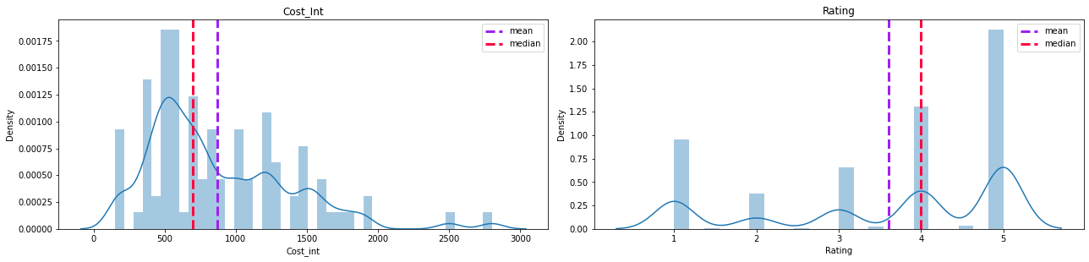
Visualizing Cost and Rating through distribution plots:

Slide 10
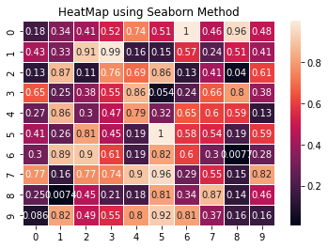
A correlation matrix is a table showing correlation coefficients between variables. Each cell in the table shows the correlation between two variables. A correlation matrix is used to summarize data, as an input into a more advanced analysis, and as a diagnostic for advanced analyses. The range of correlation is [-1,1].
Thus to know the correlation between all the variables along with the correlation coefficients, I used correlation heatmap.
From the above correlation heatmap, it can be depicted that few features are correlated, like reviewer total review is related to reviewer follower and again reviewer total review is related to pictures. Rest all correlation can be depicted from the chart.

Slide 11
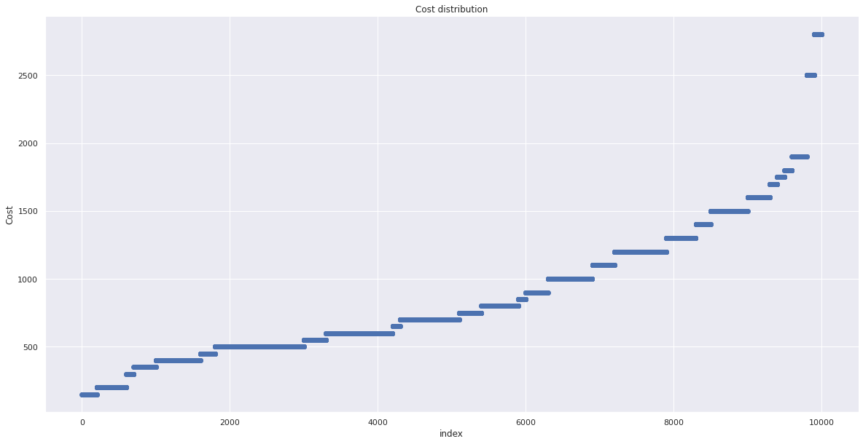
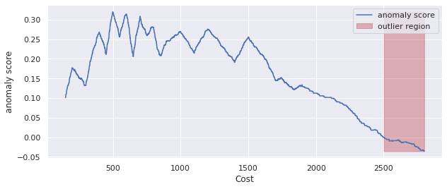
Handling Outliers:

Slide 12
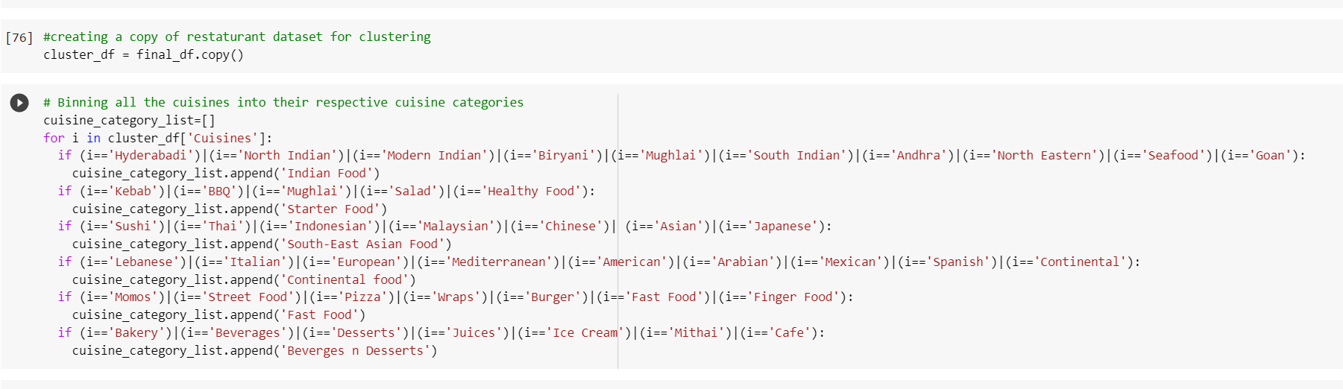
DATA PREPROCESSING
Data Preprocessing or Data Preparation is a data mining technique that transforms raw data into an understandable format for ML algorithms.
For K Means Algorithm:
Numerical variables only.
Data has no noises or outliers.
Data has a symmetric distribution of variables (it isn’t skewed).
Few numbers of dimensions.
In my project,I have binned all the cuisines into their respective cuisine
categories and created a cuisine category list. Merging the cuisine category dataframe in our cluster data frame. I have used the get_dummies method in order to generate binary values for our cuisines. I have created a final data frame that was used for the clustering process.

Slide 13
TEXTUAL DATA PREPROCESSING
Text preprocessing involves transforming text into a clean and consistent format that can then be fed into a model for further analysis and learning.
Segmentation involves breaking up text into sentences.
Tokenization stage involves converting sentences into a stream of words also called tokens. Tokens are basic building blocks upon which analysis and other methods are built.
Spell Correction includes correcting the spelling of all words in the text.
Stop Words are frequently occurring words used to construct sentences. The words that are redundant are removed at the preprocessing stage.
Stemming is the process of converting all words to their base form or stem. Stemming is also used at the preprocessing stage for applications such as emotion identification and text classification.
Lemmatization is a more advanced form of stemming and involves converting all words to their root form. It requires more processing power and time than a stemmer to generate output.
A bag-of-words model, or BoW for short, is a way of extracting features from text for use in modeling, such as with machine learning algorithms.

Slide 14
Different Machine Learning Models Used
K-Means Clustering
Agglomerative Clustering
Topic Modeling-LDA

Slide 15
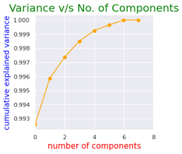
Principal Component Analysis
Principal component analysis, or PCA, is a dimensionality-reduction method that is often used to reduce the dimensionality of large data sets, by transforming a large set of variables into a smaller one that still contains most of the information in the large set.
The steps in PCA involve getting the dataset, representing data into a structure,
Standardizing the data and calculating the new features Or Principal Components.
The new features extracted from PCA are then used in the algorithms.

Slide 16
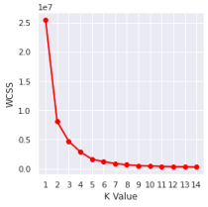
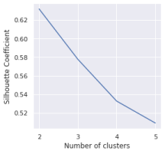
K-Means Clustering
Elbow Method:
Silhouette Score:

Slide 17
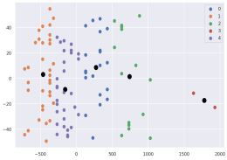
K-Means Clustering
The Elbow method was used to indicate the clusters for our data. It consists the interpretation of a line plot with an elbow shape. The number of clusters is were the elbow bends. The x axis of the plot is the number of clusters and the y axis is the Within Clusters Sum of Squares (WCSS) for each number of clusters.
Silhouette analysis can be used to study the separation distance between the resulting clusters. The silhouette plot displays a measure of how close each point in one cluster is to points in the neighboring clusters and thus provides a way to assess parameters like number of clusters visually.
The last step is to visualize the clusters. As we have 5 clusters for our model, we will visualize each cluster one by one. The output image is clearly showing the five different clusters with different colours.

Slide 18
Agglomerative Clustering
To find the optimal number of clusters by
observing the dendrograms:
From the dendrogram plot, find a
horizontal rectangle with max-height that does
not cross any horizontal vertical dendrogram
line.
The portion in the dendrogram in which a
rectangle having the max-height can be cut.
Max height rectangle is chosen because it
represents the maximum Euclidean distance
between the optimal number of clusters.
Agglomerative Clustering is a bottom-up
approach, initially, each data point is a cluster of
its own, further pairs of clusters are merged as
one moves up the hierarchy.
To obtain the desired number of clusters, the
number of clusters needs to be reduced from
initially being n clusters (n equals the total
number of data-points). Two clusters are
combined by computing the similarity between
them.

Slide 19
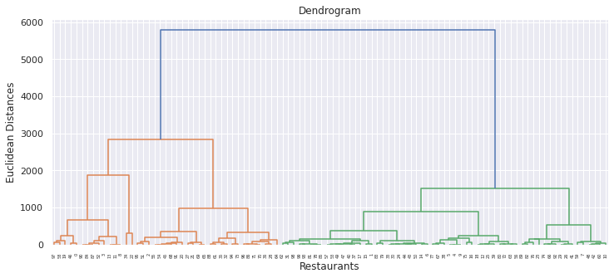
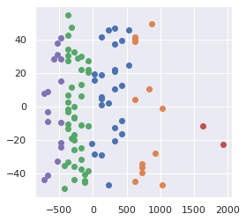
Dendrogram:
Agglomerative Clustering:

Slide 20
Sentiment Analysis
Text Analytics is the process of converting
unstructured text data into meaningful insights
to measure customer opinion, product reviews,
sentiment analysis, and customer feedback. Our
domain of expertise in this solution is driven
towards sentiment analysis.
Topic Modeling is a technique to extract the
hidden topics from large volumes of text. Latent
Dirichlet Allocation(LDA) is a popular algorithm
for topic modeling with excellent
implementations in the Python’s Gensim
package.
The challenge, however, is how to
extract good quality topics that are clear,
segregated and meaningful. This depends
heavily on the quality of text preprocessing and
the strategy of finding the optimal number of
topics.
A sentiment analysis system for text analysis
combines natural language processing and
machine learning techniques to assign weighted
sentiment scores to the entities, topics, themes
and categories within a sentence or phrase.

Slide 21
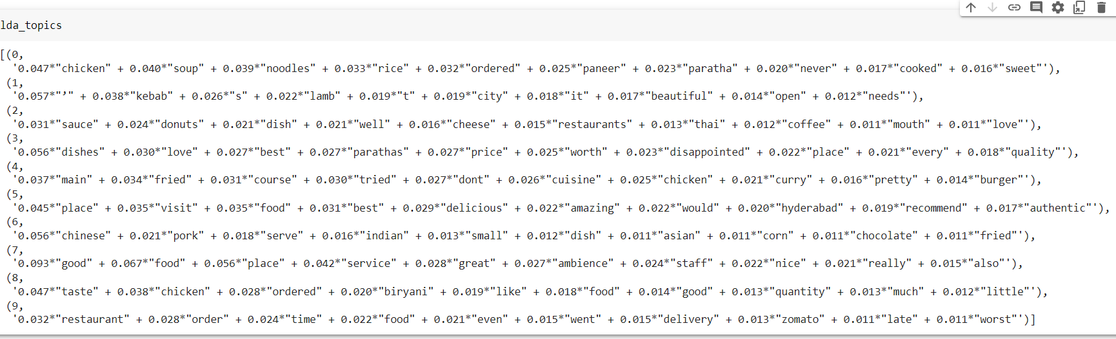
Topics Extracted:

Slide 22
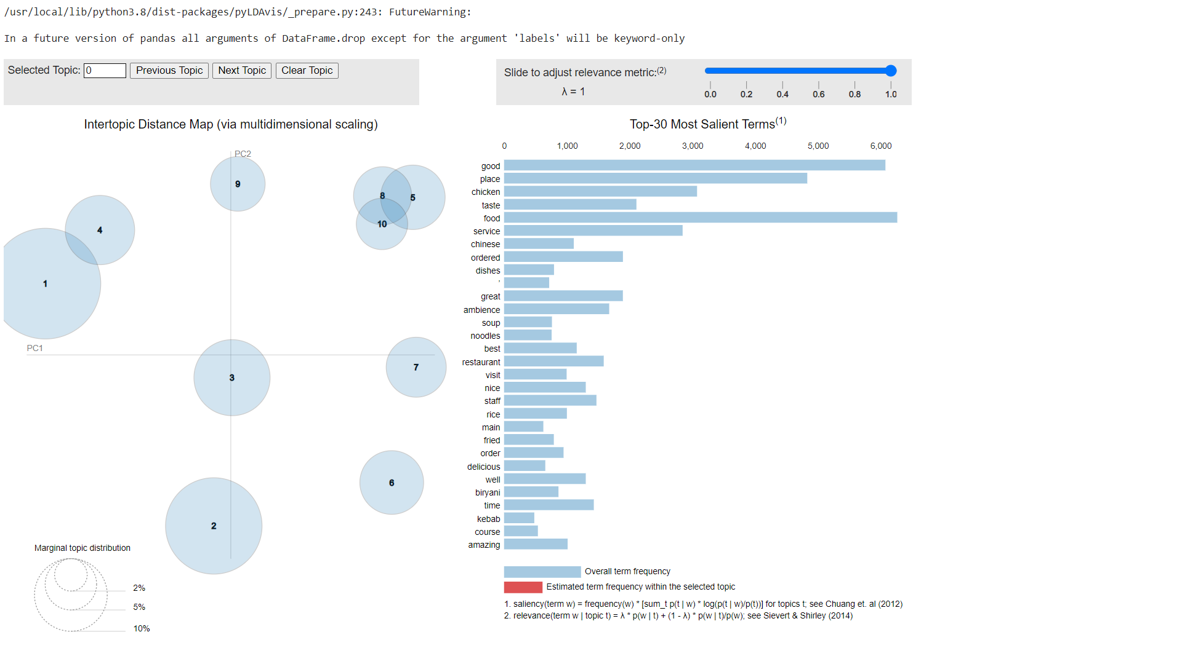
LDA Topic Modeling:

Slide 23
Conclusion
In this unsupervised machine learning project, we looked into multiple unsupervised models and sentiment analysis. We started with loading the data, inspecting the data and Data Cleaning
Through Exploratory Data Analysis, we visualized the data through bar plot, pie chart, wordcloud and distplots.
We have seen a correlation matrix is a table showing correlation coefficients between variables through heatmap.
We have the capped outliers with the highest and lowest limit using IQR method.
During data pre-processing, we have transformed raw data into an understandable format for ML algorithms.
For textual data pre-processing, NLP pipeline include steps such as sentence segmentation, word tokenization, lowercasing, stemming or lemmatization, stop word removal and spelling correction.

Slide 24
Conclusion
Principal Component Analysis was used to reduce the dimensionality of large datasets.
Models like K-means was used for grouping the data into clusters and visualizing them in clusters. Elbow method and Silhouette score was used to find the optimum number of clusters.
Agglomerative Clustering is a hierarchical clustering algorithm that was used to cluster the data points. Dendrogram plot was used to find the optimal number of clusters.
For Sentiment Analysis, topic modeling was a technique to extract the hidden topics from large volumes of text. Latent Dirichlet Allocation(LDA) is the algorithm that was used for topic modelling and extracted good quality topics that are clear, segregated and meaningful.

Slide 25
Insights
Driven by surge in online food orders especially among millennial, leading food delivery platforms are embracing machine learning models to better read fast changing consumer behaviour, minimize errors and enhance customer experiences.
K means algorithm and Agglomerative clustering has made us understand about similarity of restaurants. We understood what customers’ requirements were and what choices do they made when it comes to food. Natural Language processing helps them in serving wider geography.
Using analytics we will be able to cover all aspects from enhancing customers experience to driving their growth by increasing business.
With increasing use of technology these companies have realized the need for instant things.
With the help of analytics we will be able to give Customers great experience, drive operational efficiency and unlock Business growth

Slide 26
Challenges
Data Preprocessing was a little bit of tedious job as it involved binning several cuisines into their respective cuisine category .
Textual Preprocessing was a bit difficult.
Latent Dirichlet Allocation was a challenging job

